Slide 1
Risk Evaluation Questionnaire
Credit Institutions
October 2025
AML Analytics
RADAR

Slide 2
Agenda
Time | Topic | Speaker
9:45 | REQ Introduction | Niamh O’Malley
10:00 | XSD / XML guidance | Stephen Maher
10:40 | Tea break
11:00 | External UAT, portal | Colm Devine
11:05 | Pre-submitted questions | Ciarán Martin
11:30 | Questions and answers | All
12:00 | Close

Slide 3
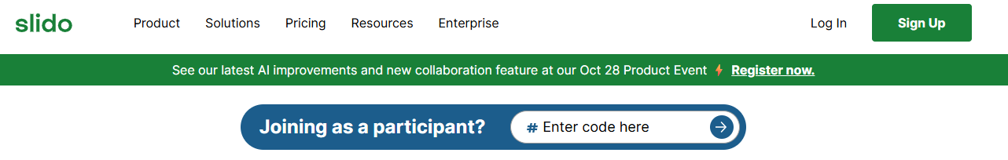
Slido
Slido #CBIREQ
Open sli.do
Open until 3pm today
#CBIREQ
Questions and answers will be published on our website

Slide 4

Uses of REQ Data
Slido #CBIREQ
AMLA Rating
CBI Supervision
National Risk Assessment
CBI Sectoral Review
CBI Thematic Reviews
Notes:
Several factors contributed to the decision to introduce the new REQ.
The Central Bank has transformed our strategy to accelerate the evolution of our risk-based supervisory approach, such that it becomes more data-driven, agile and scalable whilst having regard for FATF standards and recommendations. The new REQ is also required in the context of meeting our obligations to AMLA, the European Authority for Anti-Money Laundering and Countering the Financing of Terrorism. AMLA will coordinate national authorities to ensure the correct and consistent application of EU rules and this REQ will seek to cover the data points that are required to be collected on behalf of AMLA.
Whilst a number of the data points will be used to risk rate the firms there are also a number of other uses for the data points.
Answering No to a question is not necessarily a Red Flag as some data points will not be used for risk rating, some are included to feed into National Risk Assessments, and some for Central Bank Thematic and Sectoral Reviews. REQs have been designed for each Sector but individual business models will mean not all questions will be relevant depending on the business model of your institution, while every question may not be applicable, every data point must be completed.
The guidance details what to enter for each variable type if a question is not applicable to your institution and Stephen will go through these later.

Slide 5

Uses of REQ Data
Slido #CBIREQ
Notes:
The Central Bank AML Strategy was previously mainly driven by Onsite Inspections and Thematic Reviews. To run thematic reviews we required ad-hoc data requests from firms, going forward such data should come directly from the REQ and the number of ad hoc data requests will therefore be reduced.
Similarly, we expect the REQ data to help ensure that onsite inspections..

Slide 6

Uses of REQ Data
Slido #CBIREQ
Notes:
will become more targeted.

Slide 7
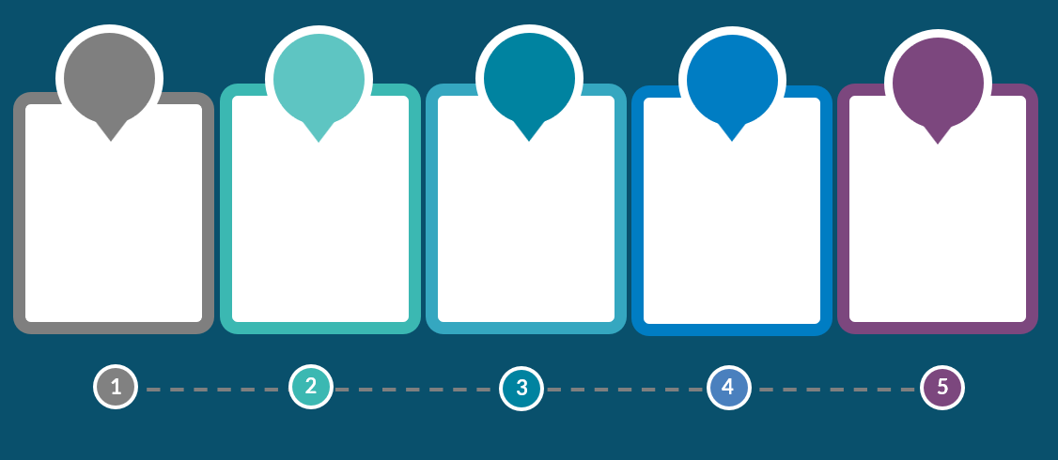





Timeframe
Jul 2024
30th Jun 2025
10th Nov 2025
27th Feb 2026
31st Aug 2026
Consultation began with BPFI
REQ public launch
External UAT
First Submission date.
Reference date for submission: 31st Dec 2024
Second Submission date.

Slide 8

Guidance notes
Slido #CBIREQ
All values should be entered in Euro unit value.
All questions are mandatory.
Several data points are requested only for ACTIVE customers, where this is the case, it will be mentioned in the guidance, otherwise assume the question refers to all customers.
Transaction data based on customer risk ratings can use the ratings as at the reference date, even if customer risk rating has changed during the year.
Notes:
The REQ Guidance Notes are available on our website and the REQ should not be completed without first reviewing this guidance.
All values should be entered in Euro. Exchange rate can be based on the time of the transactions if available or can be as at the reference date.
All questions are mandatory.
Several data points are requested for only ACTIVE customers, i.e. customers who have transacted in the preceding calendar year, where this is the case, it will be mentioned in the guidance, otherwise assume the question refers to all customers.
Transaction data based on customer risk ratings can use the ratings as at the reference date, even if customer risk rating has changed during the year.
Definitions are in line with definitions in the CJA 2010 and the AML Regulation and the AML Directive.
There have been a couple of minor updates to the guidance document since it was published in June, e.g. to fix broken links, please make sure you are always using the latest version that is on the website.

Slide 9
Slido #CBIREQ
XSD / XML Guidance
Stephen Maher
AML Analytics
Risk Analysis, Data Analytics and Reporting

Slide 10
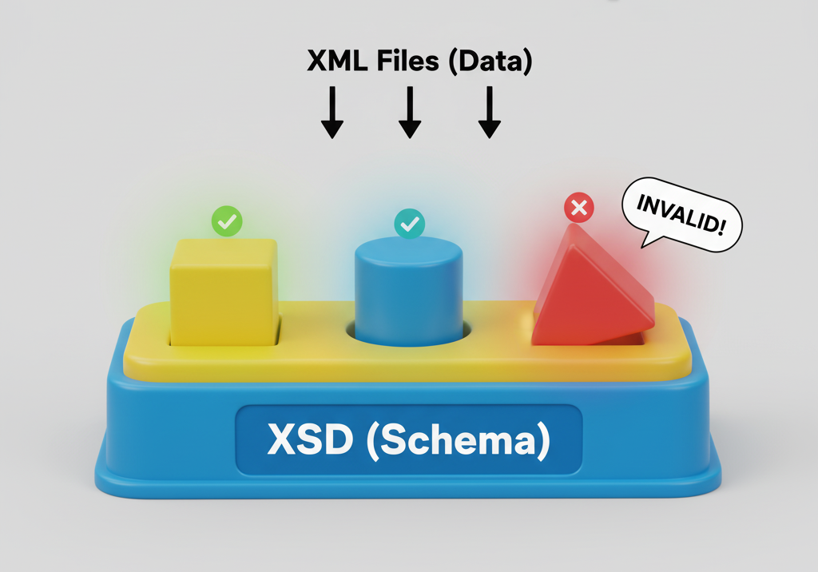
Overview of XSD and XML
Slido #CBIREQ
Notes:
Throughout this presentation, I'll be talking about two files: the XSD and the XML. If you're not from a technical background, that might sound complex, but the concept is actually very simple.
The best way to think about it is with a child's shape sorter toy.
The XSD file is the shape sorter box. It's the blueprint that defines the rules
The XML file is the collection of blocks you're trying to put into the box. It’s your firm's actual data.
If a block is the wrong shape, the XSD rejects it, and your submission will fail.

Slide 11

The XSD Schema
Slido #CBIREQ
Technical file that will accept or reject your XML file on the CBI portal
It acts as a “blueprint” for creating the XML file
Important to make your IT colleagues aware of this file
Notes:
So, let's begin by diving into the technical foundation of the REQ submission: the XSD schema.
Think of this as the digital blueprint for your data. Every single data point you submit must conform to the strict data types and rules defined within the XSD. Precision is key.
Maybe you are thinking I am not the target audience to learn about the XSD – maybe this is true but I would ask you to make your IT colleagues aware of this file.

Slide 12
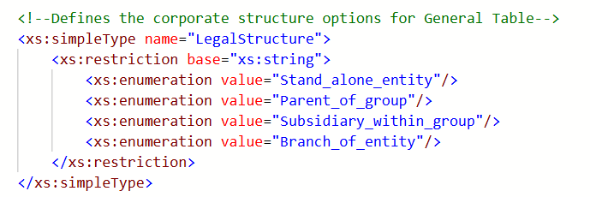
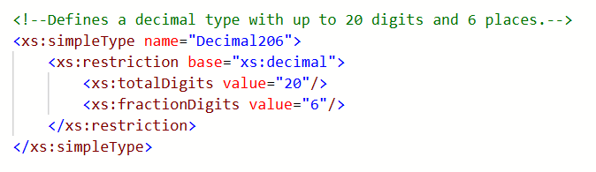
The XSD Schema
Slido #CBIREQ
The XSD contains key information:
  The root element – “CreditInstitutions”
  Defined enumeration lists. Eg LegalStructure
  Defined data types. Eg Decimal206
  Elements, attributes, minOccurs,
  maxOccurs and much more….
Notes:
The XSD schema contains a lot of information, so it can look intimidating at first glance. But let’s break down two examples to see the kind of vital rules it contains.
First, we have an 'enumeration list' for the legal structure of your company. As you can see, there are exactly four valid options. The data you submit in your XML file must be formatted to match one of these items perfectly.
Second, we see the definition for a decimal value. The rule here is clear: your number can have up to 20 digits in total, with no more than 6 of those being after the decimal point. Any other format will cause a validation error.
These are just two small examples from a very large file, but they illustrate how the XSD is packed with precise, critical information that is essential for a successful submission. Much of the information within the XSD is only contained within the XSD.

Slide 13
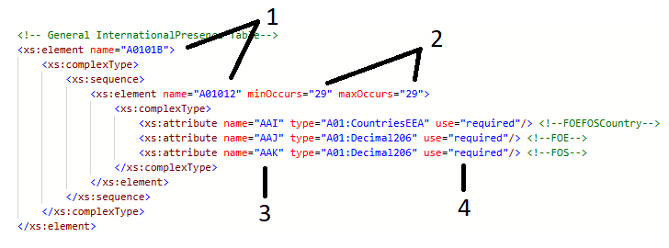
XSD – Understanding Table Structure A
Slido #CBIREQ
Technical Identifiers to be used in the XML
Set the min and max rows (not always the same)
Every tag is defined
Every tag is strictly required
Notes:
As we go deeper into the XSD, you'll find there are two different ways that tables are structured. It is crucial to understand the difference, as it changes how you build your XML.
First up is Table Structure A. Let’s use the international presence table as an example.
I wish to highlight a number of key items:
Technical identifiers (to be used in the XML file)
The min and max rows (not always the same)
Every tag is defined
Every tag is strictly required

Slide 14
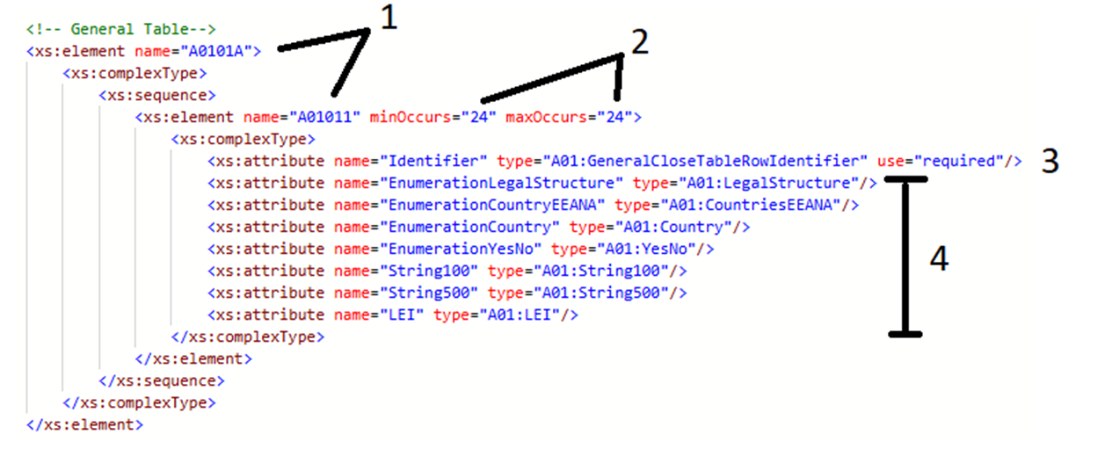
XSD – Understanding Table Structure B
Slido #CBIREQ
Technical Identifiers to be used in the XML
Set the min and max rows (always the same for a Table Structure B )
The identifier must always be reported (this is the 3 letter tag) as defined in GeneralCloseTableRowIdentifier
One of these items must be reported (as per the guidance)
Notes:
Now let's contrast that with Table Structure B. This looks quite different.
Again, I wish to highlight 4 items:
Again, we have the technical identifiers (to be used in the XML file)
The min and max are set (always the same)
Key point is the use of “identifier” (contains the 3 letter tags) which are defined in the GeneralCloseTableRowIdentifer
4 One value must be reported per tag (as defined by the guidance)

Slide 15
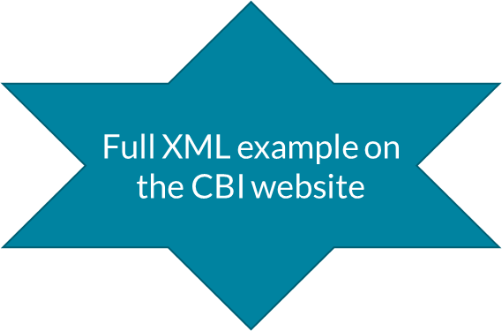
XML Submission File
Slido #CBIREQ
Only XML submissions will be accepted
Must follow the XSD “blueprint”
Data points are defined by 3 letter codes AAA, AAB, AAC etc
Key information in the guidance (.pdf) document
Notes:
Regardless of whether you use Excel, a database, or custom software to gather your data, the final output must always be a XML file that perfectly follows the XSD's rules.
It is important to remember that the guidance (.pdf) file contains essential information.
Note that there is a valid XML example on the CBI website.

Slide 16
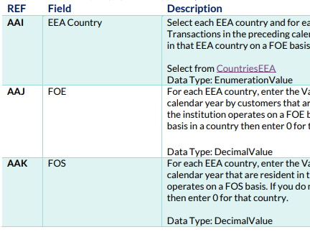
XML - Table Structure A Example
Slido #CBIREQ
<A0101B>
<A01012 AAI="AT" AAJ="932.16" AAK="576.96"></A01012>
<A01012 AAI="BE" AAJ="580.91" AAK="646.18"></A01012>
<A01012 AAI="BG" AAJ="110.15" AAK="543.86"></A01012>
....
<A01012 AAI="SK" AAJ="689.49" AAK="568.61"></A01012>
</A0101B>
Notes:
It's important to recognize the two different ways tables are built in the XML. Table Structure A and Table Structure B. The way to complete each table structure in is very different.
To build the XML file for table structure A, two items have to be reviewed in the guidance: the first column “REF” and the third column “Description”.
“REF” identifies the code associated to the specific data point while “Description” includes the Data Type for each data point.
In this example, three different “REFs” are needed, AAI, AAJ and AAK. In the third column we can see that the respective Data Types for these three fields under “Description” are “EnumerationValue”, “DecimalValue” and “DecimalValue”.
Looking at the example we can see AAI, AAJ and AAK with their respective data types.

Slide 17
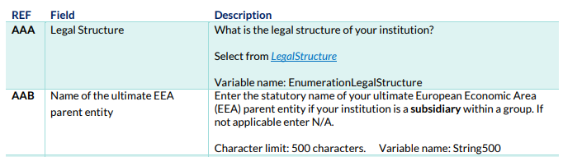
XML - Table Structure B Example
Slido #CBIREQ
<A0101A>
<A01011 Identifier="AAA" EnumerationLegalStructure="Parent_of_group"></A01011>
<A01011 Identifier="AAB" String500="gQ8GqgdVimoC"></A01011>
<A01011 Identifier="AAC" EnumerationCountryEEANA="PT"></A01011>
.....
<A01011 Identifier="BIA" String500="eJwK8ifk7SoA"></A01011>
</A0101A>
Notes:
Now we will compare with Table structure B.
Different from Table Structure A, in this case we do not use “REF” in the same way. Now we use only the items “Identifier” and Variable Name.
The Variable Name is specified under “Description” in this guidance.
We can see from the guidance for AAA under “Description” is the variable name is “EnumerationLegalStructure” while for AAB the variable name is String500.
Looking at the example we can see Identifier AAA along with the variable name – with the value selected from the LegalStructure list.
While AAB we have Identifier = AAB with String500 as the variable name with some random text in this example.

Slide 18

4 Common Errors
Slido #CBIREQ
Based on internal testing of technical and non technical testers
Important to build these learnings into your process

Slide 19
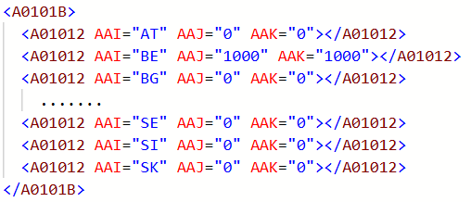
Common Error 1 - Questions that are not applicable
Slido #CBIREQ
All questions are mandatory
If a question is not applicable to your institution use one of the following options as page 6 of the guidance
  Integer Value: Enter 0
  Decimal Value: Enter 0
  Date Value: Enter 2000-01-01
  String Value: Enter N/A
  LEI: Enter 00000000000000000000
  EnumerationCountry: Select 00
  Other enumerations: Select N/A
Notes:
The first error we see is simple but we have had a lot of questions on it: every single question is mandatory.
If a field isn't relevant to your business, you can't leave it blank. You must use the designated 'not applicable' value, which is detailed on page 6 of the guidance document or as shown on screen now.
For example, if your firm only has FOE/FOS business in Belgium, you can't not report the other EEA countries. As you can see in the screen capture, you must actively report a zero value for each one.

Slide 20
Common Error 2 - XML Wrapper
Slido #CBIREQ
The XML tags must be contained in the following wrapper as page 5 of the guidance
Otherwise the file will get rejected
<?xml version="1.0" encoding="utf-8"?>
<CreditInstitutions xmlns="http://www.centralbank.ie/Schemas/AML/2025/A01">
  …
  …
  …
</CreditInstitutions>
Notes:
Our second common error relates to the XML 'wrapper'. Think of this as the address on an envelope. No matter how perfect the letter inside is, if the address is wrong, it won't get delivered.
The same applies here. If this wrapper is missing or incorrect, the entire file is immediately invalid, regardless of the data inside.
The correct wrapper is shown on screen and is also on page 5 of the guidance.
An important point to remember: the wrapper you see here is specific to credit institutions; other sectors will have a different one.

Slide 21

Common Error 3 - Table Order
Slido #CBIREQ
The XSD taxonomy defines a strict order in which the tables must be entered into any XML file
E.g. General Table (A0101A) must be 1st, General InternationalPresence Table (A0101B) must be 2nd, Inherent Risk Table (A0102A) must be 3rd in the xml file etc etc
Any file that does not follow this strict order will be rejected
Notes:
The third point is a critical technical requirement: the order of the tables in your XML file must follow a strict table order.
The XSD schema defines a strict, pre-defined sequence that must be followed.
For example, the 'General' table must always come first, followed by 'General International Presence', then 'Inherent Risk', and so on.
Note the XML example on the CBI website follows this correct table order.

Slide 22
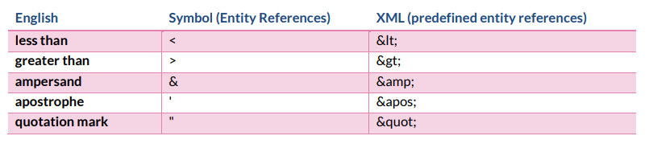
Common Error 4 - Pre-defined entity references:
Slido #CBIREQ
In XML there are 5 pre-defined characters (i.e. special characters)
Example:
  Incorrect syntax
  <A01011 Identifier="AAB" String500="Smith & Jones Ltd"></A01011>
  Correct syntax
  <A01011 Identifier="AAB" String500="Smith &amp; Jones Ltd"></A01011>
Notes:
Our fourth common error is a subtle but critical one: handling special characters.
XML reserves five specific characters that can be seen in the table below. Note this table is also on page 11 of the guidance. If these characters appear in your data, they must be 'escaped’.
For example, if your firm's name is 'Smith & Jones', the ampersand must be written as &amp;. If you don't do this, the XML structure will break, and the file will be rejected.

Slide 23

Known Technical Issues
Slido #CBIREQ
The CBI is aware of 4 technical issues within the XSD
We plan to release a hotfix once external testing has been completed
If you become aware of other technical issues please email AML_Analytics@centralbank.ie

Slide 24

Known Technical Issue 1 - Integers
Slido #CBIREQ
Please contract AML_Analytics@centralbank.ie if you believe you need to report a larger integer
In the XSD “NoNegInt20” is defined
Currently defined that a value up to 20 digits will be accepted
There is a smaller limit of 2,147,483,647 (max 32-bit signed integer)
Data type generally applies to number of customers / number of transactions
Notes:
The first known issue relates to large integer values.
The XSD technically allows for integers up to 20 digits, which is a massive number in the quintillions. However, in reality a small limit of approx. 2.1 billion applies.
This generally applies to fields for counts, like the number of customers or transactions, not decimal values. We don't expect this to be a problem, but if you believe you will need to report a value larger than 2.1 billion, please contact us.

Slide 25
Known Technical Issue 2 – Characters in Strings
Slido #CBIREQ
The guidance asks for ASCII printable characters plus € plus £ only
But the XSD is allowing some non-ASCII printable characters
E.g. ©, ÷, à and 汉
Notes:
The second issue is a discrepancy between the guidance and the XSD regarding characters.
The guidance document specifies that you should only use standard ASCII characters, plus the Euro and Pound symbols.
However, the XSD is currently less restrictive and may allow other characters to pass validation. Please adhere to the stricter rule in the guidance document.

Slide 26
Known Technical Issue 3 – Misspelling
Slido #CBIREQ
The tag ACW is a list of 24 Customer types
Currently “NP_physcially_on” is one of these 24 values
The correct spelling will be “NP_ physically_on”
The misspelling is consistent across all file. REQ excel file, guidance, XSD and more
This misspelling will be updated in the hotfix
Notes:
This next issue highlights just how precise you need to be. There is a misspelling of the word 'physically' in one of the identifiers within the schema.
The second bullet point has the incorrect spelling and the 3rd bullet point has the correct spelling.
The error is consistent across all of the files – excel file, guidance, XSD, XML etc
The error will be corrected in the hotfix.

Slide 27

Known Technical Issue 4 – Country Lists
Slido #CBIREQ
IE (Ireland) missing from an enumeration list – “CountriesEEANA”
  Affects tags AAC and AAF
XK (Kosovo) missing from an enumeration list – “Country”
  Affects all tags with a full list of counties
Notes:
Finally, there are two country codes currently missing from the enumeration lists in the XSD.
In the list of EEA countries, “CountriesEEANA”, the code 'IE' for Ireland is missing.
And in the main country list, “Country”, the code 'XK' for Kosovo is missing.
We are aware of these omissions, and they will be corrected in the hotfix.

Slide 28

4 Important Rules
Slido #CBIREQ
Please ensure that you do not have any of these mistakes in your files
You will receive an immediate resubmission request if any of these rules are failed

Slide 29
Rule 1: No duplicate tags allowed in Table Structure B
Slido #CBIREQ
For example, AAA has been reported twice
<A0101A>
<A01011 Identifier="AAA" EnumerationLegalStructure="Parent_of_group"></A01011>
<A01011 Identifier="AAB" String500="gQ8GqgdVimoC"></A01011>
<A01011 Identifier="AAA" EnumerationLegalStructure="Parent_of_group"></A01011>
.....
</A0101A>
Notes:
Rule 1 – No duplicate tags allowed in table structure B
In the example here, you can see the identifier 'AAA' has been reported twice. This is not allowed; each identifier within a table structure B table must be unique.

Slide 30
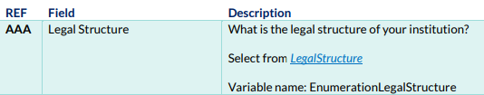
Rule 2: Make sure the correct variable names are reported for the corresponding tags in Table Structure B as per the guidance
Slido #CBIREQ
For example, “EnumerationYesNo” is not the correct variable for AAA
<A0101A>
<A01011 Identifier="AAA" EnumerationYesNo="Yes"></A01011>
<A01011 Identifier="AAB" String500="gQ8GqgdVimoC"></A01011>
<A01011 Identifier="AAC" EnumerationCountryEEANA="PT"></A01011>
.....
</A0101A>
Notes:
Rule 2 – Make sure the correct variable names are reported for the corresponding tags in table structure B as per the guidance
In this example, the identifier 'AAA' has been incorrectly paired with the variable EnumerationYesNo. The guidance clearly states it should be EnumerationLegalStructure. This mapping must be exact.

Slide 31
Rule 3: Duplicate values are not allowed in Table Structure A
Slido #CBIREQ
For example, AT has been reported twice
<A0101B>
<A01012 AAI="AT" AAJ="932.16" AAK=“576.96"></A01012>
<A01012 AAI="BE" AAJ="580.91" AAK=“646.18"></A01012>
<A01012 AAI=“AT" AAJ="110.15" AAK="543.86"></A01012>
....
</A0101B>
AAI | CountriesEEA
ACW | CustomerType
ADA | Sector
AQK | AlertType
AZD, AZI, AZY, BLA, BLL, BLU, BDE | Country
BDR | MonitoringRule (String500)
Notes:
Rule 3 – Duplicate values are not allowed in Table Structure A.
For example, in the table shown, the country code 'AT' for Austria has been reported on two separate rows. This is not permitted.
I have listed the tags where this rule applies in the table on the right hand side.

Slide 32
Rule 4: Make sure to use explicit closing tags. Self closing tags are not allowed (ie /> is not allowed)
Slido #CBIREQ
For Example /> has been used to close the tags. In this example “></A01011>” should be used.
<A0101A>
<A01011 Identifier="AAA" EnumerationLegalStructure="Parent_of_group"/>
<A01011 Identifier="AAB" String500="gQ8GqgdVimoC"/>
<A01011 Identifier="AAC" EnumerationCountryEEANA="PT"/>
.....
</A0101A>
Reminder an immediate resubmission will be required if any of these 4 rules are failed
Notes:
And our final post-submission check is a very specific technical point about your XML syntax.
Rule 4 – Make sure to use explicit closing tags. Self-closing tags are not allowed (ie /> is not allowed).
The example in red shows this incorrect format. All of our examples on the website, and in this presentation, correctly use the explicit closing tags.

Slide 33
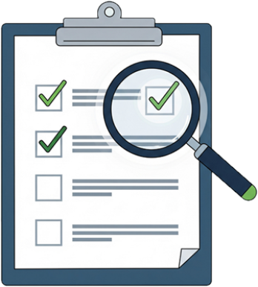
Technical Readiness Checklist
Slido #CBIREQ
Data preparation / extraction plan
Creation of the XML file (possible conversion from excel?)
XSD validation
4 additional rules that must be passed
Internal sign off & submission on CBI portal

Slide 34

Slido #CBIREQ

Slide 35
Slido #CBIREQ
External UAT
Colm Devine
Regulatory Reporting Team
RADAR

Slide 36
External UAT
Slido #CBIREQ
Monday November 10th to Friday November 21st.
During the test phase we will have dedicated resources to answer queries and log defects.
This test phase will use the Test Portal, and is available here: https://test-portal.centralbank.ie.
If your firm does not have an administrator set up with access to the Test Portal, please contact onlinereturns@centralbank.ie as soon as possible
Notes:
During the test phase we will have dedicated resources to answer queries and log defects. Firms can continue to test the return after these dates, but there could be a delay in investigating any defects that are identified.
If your firm doesn’t have an administrator set up with access to the Test Portal, please email onlinereturns@centralbank.ie as soon as possible to ensure your access is set up in advance of testing. Make sure to emphasise in the email that you want access to the Test Portal.

Slide 37
External UAT
Slido #CBIREQ
Logging a Defect
It is the responsibility of your institution to upload a valid return file.
If the defect is not XSD taxonomy related, please ensure that you can reproduce the defect before logging it.
To log a defect, please send the details of the defect to AML_Analytics@centralbank.ie.
A member of our test team will contact you in relation to your defect.
Notes:
If you come across issues when testing.
If the defect is an XSD taxonomy error, please correct the file to pass your own internal taxonomy checks. We will not investigate any XSD taxonomy errors. It is the responsibility of your institution to upload a valid return file.
If the defect is not XSD taxonomy related, please make sure that you can reproduce the defect before logging it.
To log a defect, please send details of the defect to AML_Analytics@centralbank.ie, providing as much information as possible, like step-by-step instructions to reproduce the defect, screenshots and the sample file causing the issue.
We will then investigate and get back to you about your defect.

Slide 38
Portal
Slido #CBIREQ
Naming convention
The file name must be of the form:
CCCCCC_YYYYMMDD_A01.xml
CCCCCC - the institution code you use to log in to the system
YYYYMMDD - must be the reporting date
A01 - the A01 Return code
.xml or .zip - the file extension
File Size Constraints
There is no guidance on the expected file size. We have tested large files internally for example:
A very large file would be approx. 1MB
This file has business in every country in the world
2000+ transaction monitoring rules
We would expect most files to be less than 500KB. Both the small and larger files do tend to process quickly on the CBI portal.
Notes:
The file name must follow the naming convention in the slide. The reporting date for testing will be the 31st of December 2024.
As part of our internal testing we uploaded large files, and they processed quickly on the Portal, so we do not expect any file size constraints.

Slide 39
Slido #CBIREQ
Pre-submitted Questions
Ciarán Martin
AML Analytics
RADAR

Slide 40
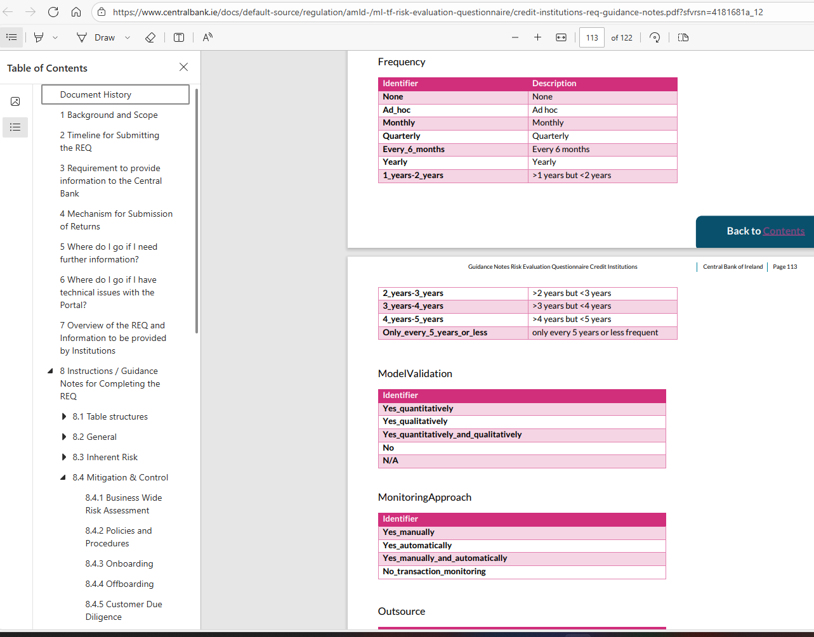
Questions - navigation
Slido #CBIREQ
How do I get back to where I was in the document when I click on a hyperlink down to the Appendix?
Remember the page you were on or navigate back to the required section using left-hand side.
Alternatively, if you are using a PDF reader software like Adobe Acrobat, the Alt Left Arrow shortcut will return you to the page location of the link you clicked

Slide 41
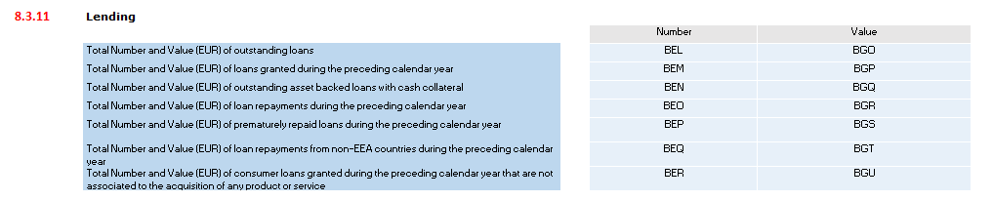
Questions - Lending
Slido #CBIREQ
BEN – Outstanding asset backed loans with cash collateral – are these a Subset of BEL?
BEL – For outstanding loans. What loans are included in this? Mortgages, home improvement loans, operating leases?
Yes
Include ALL loans

Slide 42
Questions – Pooled Accounts
Slido #CBIREQ
What is intended to be captured within the Pooled Accounts Tab.
For instance, is it intended to capture all transactions to/from pooled accounts in each of the jurisdictions where a firm operates a branch? Or is it intended to capture the transactions to/from pooled accounts of customers domiciled within each jurisdiction?
It is the latter interpretation. The country selected should be based on the country of domicile of the customer’s bank account.

Slide 43
Questions – Group Reporting
Slido #CBIREQ
AAI – We are a branch writing FOE business in Ireland but Ireland is not a listed country in AAI, how do we report this?
My institution is part of a group with multiple institutions regulated by the Central Bank, can the group submit just one REQ for all institutions?
My firm is a branch of an institution authorised by another European NCA, do we need to report the data for all firms that fall under the group?
No, each individual institution must submit a REQ.
No, we only expect you to report the data for the Irish branch.
As you are reporting from the perspective of the branch, not from the perspective of the group, we are treating Ireland as your host country which is why it is not located in the FOE/FOS list.

Slide 44
Questions – Group Reporting
Slido #CBIREQ
State whether a foreign supervisory authority issued findings on your institution's risk management. As we are a branch, should this include findings on the group as a whole, or only findings specific to Dublin branch?
We have multi-hub locations in one domicile for one legal entity (i.e. Dublin and Limerick). Would Limerick count as a representative office?
If the Limerick hub is providing direct services to customers, for which AML obligations apply, then yes, however if it’s only an operational hub then it would not count.
Only on finding specific to the Irish branch.

Slide 45
Questions – Group Reporting
Slido #CBIREQ
Noting that one of the purposes of the REQ will be to inform the supervisory agenda of AMLA, firms would welcome guidance around the inclusion of data for non-EEA branches within the firm's REQ.
In Section 7 (Mitigation & Control) there are two questions relating to CDD: "Are intragroup activities identified?" and "Are intragroup transactions identified?"
Could some examples be given in guidance to illustrate what types of activities/transactions these two questions are intended to capture?
Firms should not include transactions for non-EEA branches.
Data relating to third country branches would be used to assess the group risk but are not used for direct supervision selection.
An intragroup activity is a service provided by one or more members of a group to another member of the same group, such as management, accounting, legal, IT or HR, etc.
An intragroup transaction is any economic exchange, such as the sale of goods, services, or assets, that occurs between two or more companies within the same corporate group.

Slide 46
Questions – Group Reporting
Slido #CBIREQ
Should data from wholly owned subsidiaries be kept separate from the parent REQ or should the parent entity aggregate up all the customer data and transactions to its REQ?
Each firm within the group should report on an individual basis e.g. if there is a parent and two subsidiaries regulated by the Central Bank then each of the three firms should submit their own REQ.
If a firm has several branches, then the firm should aggregate the branch information in the REQ e.g. a firm has two branches one in Germany and the other in France . That firm should aggregate the branch information into its REQ. However, the two branches may also be required to submit information to the supervisory authority in their own jurisdiction.

Slide 47
Questions – Alerts
Slido #CBIREQ
Under "manual transaction monitoring systems" in section 8.4.7 Alerts, is this intended to capture so called "manual alerts", by which we mean suspicions raised by teller staff in branches relating to customer transactional activity?
A manual alert is any alert that is not automatically generated by a system, suspicions raised by tellers is included in this.

Slide 48
Questions – Intermediaries and Distribution Channels
Slido #CBIREQ
There is a question requiring firms to disclose the number of intermediaries “that are not themselves obliged entities". Members suggest expanding the scope of this question to also include credit intermediaries which are not obliged entities, but which are authorised and regulated by the Competition and Consumer Protection Commission. Although not designated persons, these intermediaries are nonetheless regulated.
Obliged entities are defined in the AMLR, only obliged entities under the AMLR are included in this scope.

Slide 49

Questions
Slido #CBIREQ

Slide 50
Questions
Slido #CBIREQ
Step One: Refer to guidance document available on our website:
https://www.centralbank.ie/regulation/anti-money-laundering-and-countering-the-financing-of-terrorism/sector-specific-ml-tf-risk-evaluation-questionnaire
Step Two: Refer to Q&A document which will be on our website by the end of October
Step Three: Email to: AML_Analytics@centralbank.ie

Slide 51
Slido #CBIREQ
Thank you for your attention

