Slide 1
Risk Evaluation Questionnaire
Payment and E-money Institutions
October 2025
AML Analytics
Risk Analysis, Data Analytics and Reporting

Slide 2
Agenda
Time | Topic | Speaker
9:45 | Introduction | Anthony Cahalan
9:50 | REQ essentials | Niamh O’Malley
10:05 | XSD / XML guidance | Stephen Maher
10:45 | Tea break
11:00 | External UAT, portal | Colm Devine
11:05 | Pre-submitted questions | Ciarán Martin
11:30 | Questions and answers | All
12:15 | Close

Slide 3
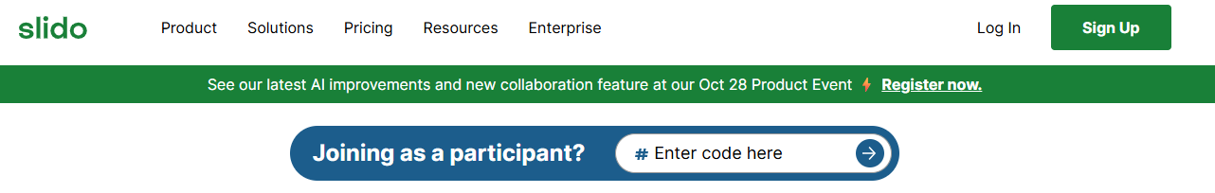
Slido
Slido #PIEMI
Open sli.do
Open until 3pm today
#PIEMI
Questions and answers will be published on our website

Slide 4

Uses of REQ Data
Slido #PIEMI
AMLA Rating
CBI Supervision
National Risk Assessment
CBI Sectoral Review
CBI Thematic Reviews
Notes:
Several factors contributed to the decision to introduce the new REQ.
The Central Bank has transformed our strategy to accelerate the evolution of our risk-based supervisory approach, such that it becomes more data-driven, agile and scalable whilst having regard for FATF standards and recommendations. The new REQ is also required in the context of meeting our obligations to AMLA. AMLA will coordinate national authorities to ensure the correct and consistent application of EU rules and this REQ will seek to cover the data points that are required to be collected on behalf of AMLA.
Whilst a number of the data points will be used to risk rate the firms there are also a number of other uses for the data points.
Answering No to a question is not necessarily a Red Flag as some data points will not be used for risk rating, some are included to feed into National Risk Assessments, and some for Central Bank Thematic and Sectoral Reviews. REQs have been designed for each Sector but individual business models will mean not all questions may be relevant depending on the business model of your institution, while every question may not be applicable, every data point must be completed.
The guidance gives details what to enter for each variable type if a question is not applicable to your institution and Stephen will go through these later.

Slide 5

Uses of REQ Data
Slido #PIEMI
Notes:
The Central Bank AML Strategy was previously mainly driven by Onsite Inspections and Thematic Reviews. To run thematic reviews we required ad-hoc data requests from firms, going forward such data should come directly from the REQ and the number of ad hoc data requests will therefore be reduced.
Similarly, we expect the REQ data to help ensure that onsite inspections

Slide 6

Uses of REQ Data
Slido #PIEMI
Notes:
will become more targeted.

Slide 7
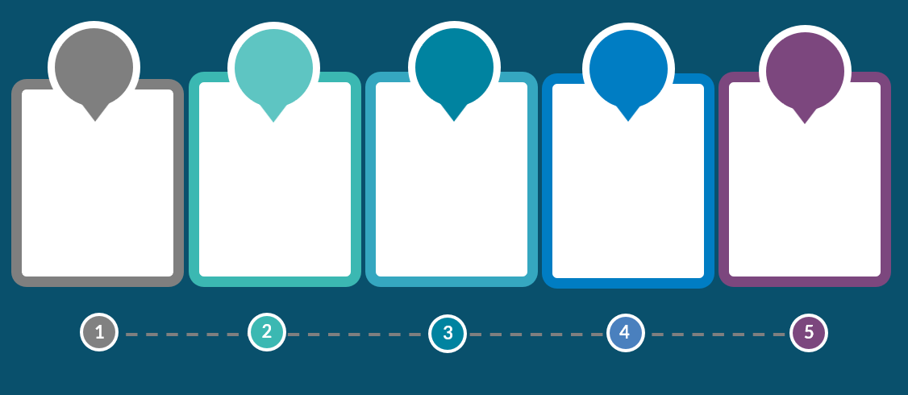





Timeframe
Q2 2024
30th Jun 2025
17th Nov 2025
13th Feb 2026
31st Aug 2026
Consultation began with EMA
REQ public launch
External UAT
First Submission date.
Reference date for submission: 31st Dec 2024
Second Submission date.
Notes:
Consultation with the EMA began in Q2 24 on the new REQ. The EMA were very helpful during this consultation and the final REQ that was launched on the Central Bank website on 30 June is a refined version of the original design thanks to this consultation.
External UAT will open on November 17th and Colm will speak about this later.
The first Submission Date is 13 Feb 2026
The first submission deadline was extended as institutions requested more time for the first submission so there will be two submissions in 2026 for Payment and E-money Institutions but it will be an annual return going forward.
The reference date for data included in the REQ is 31 December of the preceding calendar year unless otherwise stated. Given the extended timeline for the first submission the reference date for the first submission is 31 December 2024. If, for example, you are answering a question which requests the date the most recent report was submitted to senior management, this would mean the most recent as of 31 December 2024.
The second Submission Date is 31 August 2026
Submission Dates in Future will become more stable and will always be based on the previous calendar year.
The REQ will be available on the Portal at least two weeks before the submission date.

Slide 8

Group Reporting
Slido #PIEMI
Caveat: Guidance is as per our current viewpoint and will apply for the first submission. However, once the AMLA RTS has been published, if there is conflicting guidance to the guidance given here, we may need to revise our viewpoint for future submissions.

Slide 9
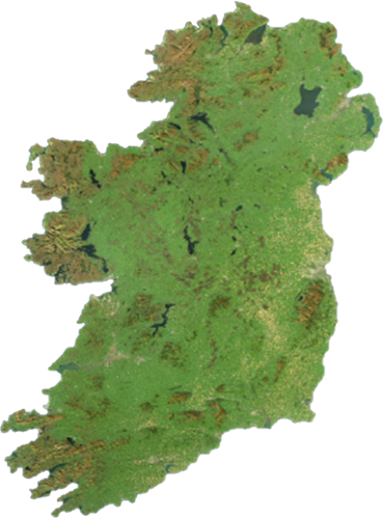

Irish Branch
Slido #PIEMI
Firm is a branch of an institution authorised by another European NCA
Only report data for the Irish branch
Notes:
If your Firm is a branch of an institution authorised by another European NCA, Only report data for the Irish branch

Slide 10

Multiple institutions regulated by the Central Bank
Slido #PIEMI
Each individual institution must submit an REQ
Notes:
If you are a part of a group that has multiple institutions that are regulated by the Central Bank of Ireland then each individual institution must submit an REQ.

Slide 11

EU Parent undertaking regulated by the Central Bank
Slido #PIEMI
Aggregate the EEA branch information in the REQ
Notes:
If you are an EU Parent undertaking regulated by the Central Bank of Ireland then you must Aggregate all of the EEA branch information in the REQ

Slide 12

EU Parent undertaking regulated by the Central Bank
Slido #PIEMI
Aggregate the EEA branch information in the REQ – DO NOT include non-EEA branch data
X
Notes:
But DO NOT include the non-EEA branch data

Slide 13
Multiple institutions regulated by different NCAs – Irish firm NOT EU Parent
Slido #PIEMI
Only report for Irish institution
X
X
Notes:
If you are a part of a group that has multiple institutions that are regulated by different NCAs but your firms is not the EU parent then you only need to report for the Irish institution.

Slide 14

Guidance notes
Slido #PIEMI
All values should be entered in Euro unit value.
All questions are mandatory.
Several data points are requested only for ACTIVE customers. Where this is the case, it will be mentioned in the guidance, otherwise assume the question refers to all customers.
Transaction data based on customer risk ratings can use the ratings as at the reference date, even if customer risk rating has changed during the year.
Notes:
The REQ Guidance Notes are available on our website and the REQ should not be completed without first reviewing this guidance.
All values should be entered in Euro. Exchange rate can be based on the time of the transactions if available or can be as at the reference date.
All questions are mandatory.
Several data points are requested for only ACTIVE customers, i.e. customers who have transacted in the preceding calendar year, where this is the case, it will be mentioned in the guidance, otherwise assume the question refers to all customers.
Transaction data based on customer risk ratings can use the ratings as at the reference date, even if customer risk rating has changed during the year.
Definitions are in line with definitions in the CJA 2010 and the AML Regulation and the AML Directive.
There have been a couple of minor updates to the guidance document since it was published in June, e.g. to fix broken links, please make sure you are always using the latest version that is on the website.

Slide 15
Slido #PIEMI
XSD / XML Guidance
Stephen Maher
AML Analytics
Risk Analysis, Data Analytics and Reporting

Slide 16
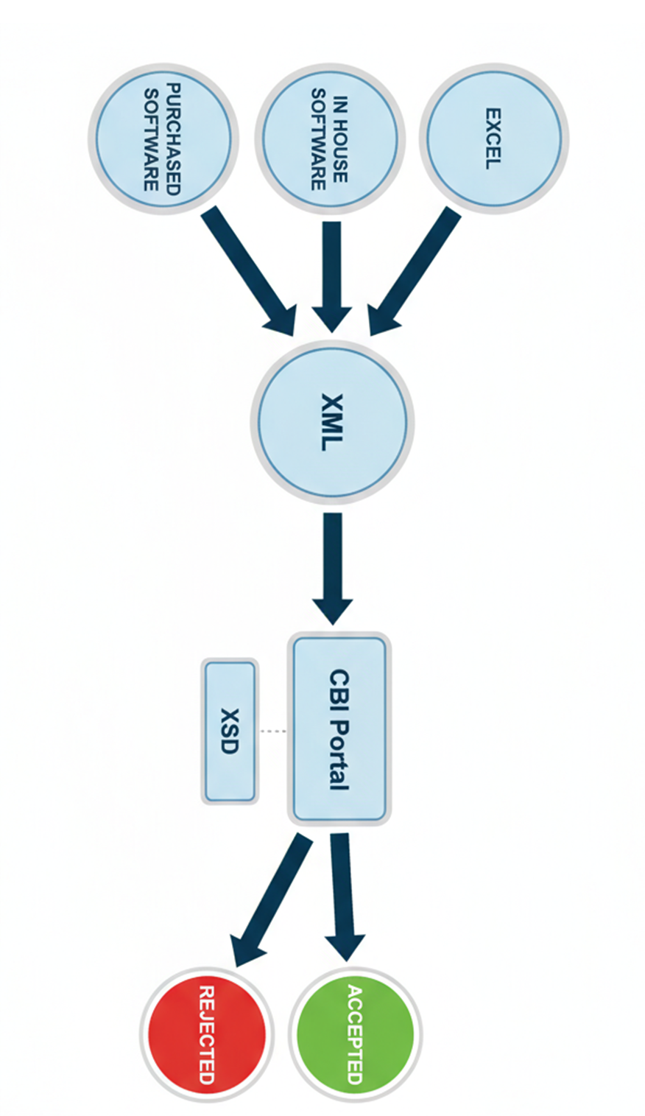
Overview of XSD and XML
Slido #PIEMI
Notes:
The old REQ was an excel based submission so there is a step change needed when working with XML files.
Today I will focus on the items within the red circle – mainly the XML and XSD files. Later my colleague Colm will discuss the CBI portal.
The items to the left of this circle – excel, in house software and purchased software. Or if you choose purely to work in XML is a choice to be made on a firm by firm basis. There are no right or wrong answers in this regard.
The end result is that all firms will be submitting a single XML file.
So my focus will be on XML and the XSD (which contains all of the rules).
I want to walk you through some key insights we've gained that will help you submit a valid XML file right from the start.

Slide 17

The XSD Schema
Slido #PIEMI
Technical file that will accept or reject your XML file on the CBI portal
It acts as a “blueprint” for creating the XML file
Important to make your IT colleagues aware of this file
Notes:
So, let's begin by diving into the technical foundation of the REQ submission: the XSD schema.
Think of this as the digital blueprint for your data. Every single data point you submit must conform to the strict data types and rules defined within the XSD. Precision is key.
Maybe you are thinking I am not the target audience to learn about the XSD – maybe this is true but I would ask you to make your IT colleagues aware of this file.

Slide 18
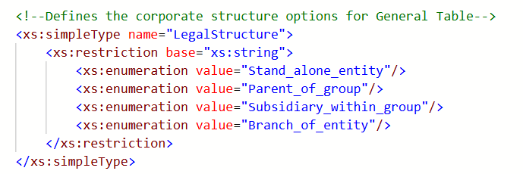
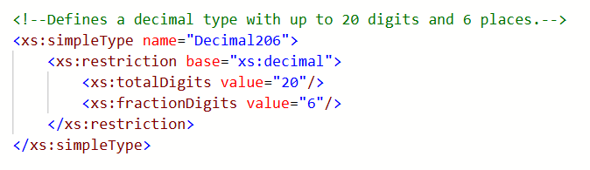
The XSD Schema
Slido #PIEMI
The XSD contains key information:
  The root element – “PIandEMI”
  Defined enumeration lists. Eg LegalStructure
  Defined data types. Eg Decimal206
  Elements, attributes, minOccurs,
  maxOccurs and much more….
Notes:
The XSD schema contains a lot of information, so it can look intimidating at first glance. But let’s break down two examples to see the kind of vital rules it contains.
First, we have an 'enumeration list' for the legal structure of your company. As you can see, there are exactly four valid options. The data you submit in your XML file must be formatted to match one of these items perfectly.
Second, we see the definition for a decimal value. The rule here is clear: your number can have up to 20 digits in total, with no more than 6 of those being after the decimal point. Any other format will cause a validation error.
These are just two small examples from a very large file, but they illustrate how the XSD is packed with precise, critical information that is essential for a successful submission. Much of the information within the XSD is only contained within the XSD.

Slide 19
XSD – Understanding Table Structure A
Slido #PIEMI
Technical Identifiers to be used in the XML
Set the min and max rows (not always the same)
Every tag is defined
Every tag is strictly required
Notes:
As we go deeper into the XSD, you'll find there are two different ways that tables are structured. It is crucial to understand the difference, as it changes how you build your XML.
First up is Table Structure A. Let’s use the international presence table as an example.
I wish to highlight a number of key items:
Technical identifiers (to be used in the XML file)
The min and max rows (not always the same)
Every tag is defined
Every tag is strictly required

Slide 20
XSD – Understanding Table Structure B
Slido #PIEMI
Technical Identifiers to be used in the XML
Set the min and max rows (always the same for a Table Structure B )
The identifier must always be reported (this is the 3 letter tag) as defined in GeneralCloseTableRowIdentifier
One of these items must be reported (as per the guidance)
Notes:
Now let's contrast that with Table Structure B. This looks quite different.
Again, I wish to highlight 4 items:
Again, we have the technical identifiers (to be used in the XML file)
The min and max are set (always the same)
Key point is the use of “identifier” (contains the 3 letter tags) which are defined in the GeneralCloseTableRowIdentifer
One value must be reported per tag (as defined by the guidance)

Slide 21
XML Submission File
Slido #PIEMI
Only XML submissions will be accepted
Must follow the XSD “blueprint”
Data points are defined by 3 letter codes CAA, CAB, CAC etc
Key information in the guidance (.pdf) document
Notes:
We've looked at the XSD blueprint. Now let's talk about the final file you'll actually submit: the XML file.
Regardless of whether you use Excel or other software to gather your data, the final output must always be a XML file that perfectly follows the XSD's rules.
It is important to remember that the guidance (.pdf) file contains essential information.
Note that there is a valid XML example on the CBI website – highlighted in red on screen.

Slide 22
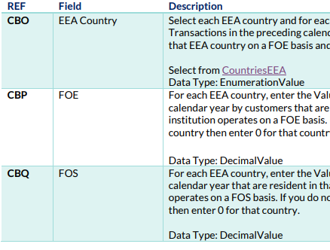
XML - Table Structure A Example
Slido #PIEMI
<A0201B>
<A02012 CBO="AT" CBP="263.37" CBQ="407.06"></A02012>
<A02012 CBO="BE" CBP="987.28" CBQ="923.11"></A02012>
<A02012 CBO="BG" CBP="420.65" CBQ="170.98"></A02012>
....
<A02012 CBO="SK" CBP="887.44" CBQ="981.47"></A02012>
</A0201B>
Notes:
It's important to recognize the two different ways tables are built in the XML. Table Structure A and Table Structure B. The way to complete each table structure in is very different.
To build the XML file for table structure A, two items have to be reviewed in the guidance: the first column “REF” and the third column “Description”.
“REF” identifies the code associated to the specific data point while “Description” includes the Data Type for each data point.
In this example, three different “REFs” are needed; CBO, CBP and CBQ. In the third column we can see that the respective Data Types for these three fields under “Description” are “EnumerationValue”, “DecimalValue” and “DecimalValue”.
Looking at the example we can see CBO, CBP and CBQ with their respective data types.

Slide 23
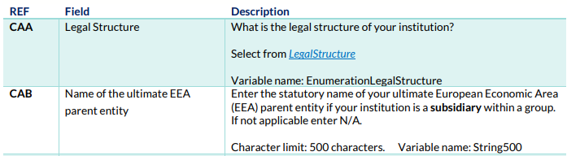
XML - Table Structure B Example
Slido #PIEMI
<A0201A>
<A02011 Identifier="CAA" EnumerationLegalStructure="Parent_of_group"></A02011>
<A02011 Identifier="CAB" String500="CvN3XIMhg6CX"></A02011>
<A02011 Identifier="CAC" LEI="1DWEEMTDKDT3X4T9EWGD"></A02011>
....
<A02011 Identifier="CBV" EnumerationYesNo="Yes"></A02011>
</A0201A>
Notes:
Now we will compare with Table structure B.
Different from Table Structure A, in this case we do not use “REF” in the same way. Now we use only the items “Identifier” and Variable Name.
The Variable Name is specified under “Description” in this guidance.
We can see from the guidance for CAA under “Description” is the variable name is “EnumerationLegalStructure” while for CAB the variable name is String500.
Looking at the example we can see Identifier CAA along with the variable name – with the value selected from the LegalStructure list.
While CAB we have Identifier = CAB with String500 as the variable name with some random text in this example.

Slide 24

4 Common Errors
Slido #PIEMI
Based on internal testing of technical and non technical testers
Important to build these learnings into your process

Slide 25
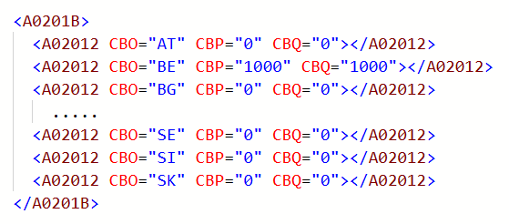
Common Error 1 - Questions that are not applicable
Slido #PIEMI
All questions are mandatory
If a question is not applicable to your institution use one of the following options as page 7 of the guidance
  Integer Value: Enter 0
  Decimal Value: Enter 0
  Date Value: Enter 2000-01-01
  String Value: Enter N/A
  LEI: Enter 00000000000000000000
  EnumerationCountry: Select 00
  Other enumerations: Select N/A
Notes:
The first error we see is simple but we have had a lot of questions on it: every single question is mandatory.
If a field isn't relevant to your business, you can't leave it blank. You must use the designated 'not applicable' value, which is detailed on page 7 of the guidance document or as shown on screen now.
For example, if your firm only has FOE/FOS business in Belgium, you can't not report the other EEA countries. As you can see in the screen capture, you must actively report a zero value for each one.

Slide 26
Common Error 2 - XML Wrapper
Slido #PIEMI
The XML tags must be contained in the following wrapper as page 5 of the guidance
Otherwise the file will get rejected
<?xml version="1.0" encoding="utf-8"?>
<PIandEMI xmlns="http://www.centralbank.ie/Schemas/AML/2025/A02">
...
...
...
</PIandEMI>
Notes:
Our second common error relates to the XML 'wrapper'. Think of this as the address on an envelope. No matter how perfect the letter inside is, if the address is wrong, it won't get delivered.
The same applies here. If this wrapper is missing or incorrect, the entire file is immediately invalid, regardless of the data inside.
The correct wrapper is shown on screen and is also on page 5 of the guidance.
An important point to remember: the wrapper you see here is specific to the Payment Institutions & Electronic Money Institutions; other sectors will have a different one.

Slide 27

Common Error 3 - Table Order
Slido #PIEMI
The XSD taxonomy defines a strict order in which the tables must be entered into any XML file
E.g. General Table (A0201A) must be 1st, General InternationalPresence Table (A0201B) must be 2nd, Inherent Risk Table (A0202A) must be 3rd in the xml file, etc., etc.
Any file that does not follow this strict order will be rejected
Notes:
The third point is a critical technical requirement: the order of the tables in your XML file must follow a strict table order.
The XSD schema defines a strict, pre-defined sequence that must be followed.
For example, the 'General' table must always come first, followed by 'General International Presence', then 'Inherent Risk', and so on.
Note the XML example on the CBI website follows this correct table order.

Slide 28
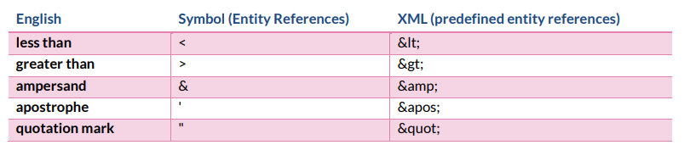
Common Error 4 - Pre-defined entity references:
Slido #PIEMI
In XML there are 5 pre-defined characters (i.e. special characters)
Example:
  Incorrect syntax
  <A02011 Identifier=“CAB" String500="Smith & Jones Ltd"></A02011>
  Correct syntax
  <A02011 Identifier=“CAB" String500="Smith &amp; Jones Ltd"></A02011>
Notes:
Our fourth common error is a subtle but critical one: handling special characters.
XML reserves five specific characters that can be seen in the table below. Note this table is also on page 11 of the guidance. If these characters appear in your data, they must be 'escaped’.
For example, if your firm's name is 'Smith & Jones', the ampersand must be written as &amp;. If you don't do this, the XML structure will break, and the file will be rejected.
Note to self: ampersand amp semicolon

Slide 29

Known Technical Issues
Slido #PIEMI
The CBI is aware of 4 technical issues within the XSD
We plan to release a hotfix once external testing has been completed
If you become aware of other technical issues please email AML_Analytics@centralbank.ie

Slide 30

Known Technical Issue 1 - Integers
Slido #PIEMI
Please contract AML_Analytics@centralbank.ie if you believe you need to report a larger integer
In the XSD “NoNegInt20” is defined
Currently defined that a value up to 20 digits will be accepted
There is a smaller limit of 2,147,483,647 (max 32-bit signed integer)
Data type generally applies to number of customers / number of transactions
Notes:
The first known issue relates to large integer values.
The XSD technically allows for integers up to 20 digits, which is a massive number in the quintillions. However, in reality a small limit of approx. 2.1 billion applies.
This generally applies to fields for counts, like the number of customers or transactions, not decimal values. We don't expect this to be a problem, but if you believe you will need to report a value larger than 2.1 billion, please contact us.

Slide 31
Known Technical Issue 2 – Characters in Strings
Slido #PIEMI
The guidance asks for ASCII printable characters plus € plus £ only
But the XSD is allowing some non-ASCII printable characters
E.g. ©, ÷, à and 汉
Notes:
The second issue is a discrepancy between the guidance and the XSD regarding characters.
The guidance document specifies that you should only use standard ASCII characters, plus the Euro and Pound symbols.
However, the XSD is currently less restrictive and may allow other characters to pass validation. Please adhere to the stricter rule in the guidance document.

Slide 32
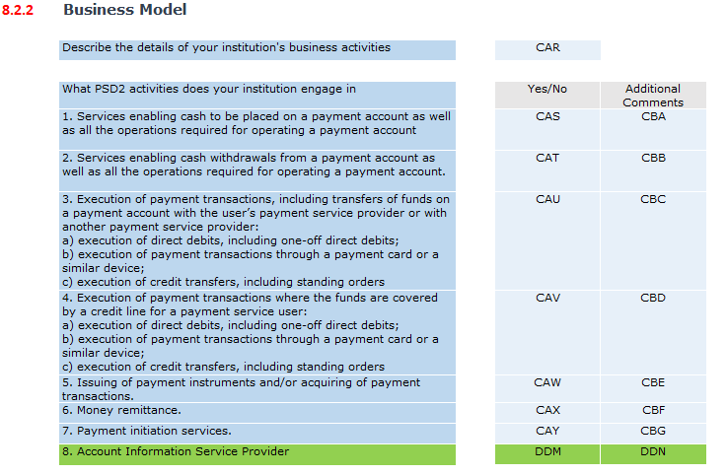
Known Technical Issue 3 – PSD2 Activities
Slido #PIEMI
Account Information Service Provider was omitted from the list of PSD2 activities
2 extra tags to be added as per the screen capture (in green)
The Guidance, XSD, sample XML will also be updated
Notes:
The third known technical issue we have had a number of questions about.
The issue is the omission of PSD2 activity number 8 – Account Information Service Provider.
Two new data points will be added to the REQ – these can be seen on screen now in green.
These two new data point will lead to updates to all files published on the website – excel template, guidance, XSD, XML example etc etc

Slide 33

Known Technical Issue 4 – Country Lists
Slido #PIEMI
IE (Ireland) missing from an enumeration list – “CountriesEEANA”
  Affects tags CAD and CAJ
XK (Kosovo) missing from an enumeration list – “Country”
  Affects all tags with a full list of counties
Notes:
Finally, there are two country codes currently missing from the enumeration lists in the XSD.
In the list of EEA countries, “CountriesEEANA”, the code 'IE' for Ireland is missing.
And in the main country list, “Country”, the code 'XK' for Kosovo is missing.
We are aware of these omissions, and they will be corrected in the hotfix.

Slide 34

4 Important Rules
Slido #PIEMI
Please ensure that you do not have any of these mistakes in your files
You will receive an immediate resubmission request if any of these rules are failed

Slide 35
Rule 1: No duplicate tags allowed in Table Structure B
Slido #PIEMI
For example, CAA has been reported twice
<A0201A>
<A02011 Identifier="CAA" EnumerationLegalStructure="Parent_of_group"></A02011>
<A02011 Identifier="CAB" String500="CvN3XIMhg6CX"></A02011>
<A02011 Identifier="CAA" EnumerationLegalStructure="Parent_of_group"></A02011>
....
</A0201A>
Notes:
Rule 1 – No duplicate tags allowed in table structure B
In the example here, you can see the identifier ‘CAA' has been reported twice. This is not allowed; each identifier within a table structure B table must be unique.

Slide 36
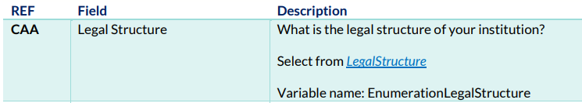
Rule 2: Make sure the correct variable names are reported for the corresponding tags in Table Structure B as per the guidance
Slido #PIEMI
For example, “EnumerationYesNo” is not the correct variable for CAA
<A0201A>
<A02011 Identifier="CAA" EnumerationYesNo="Yes"></A02011>
<A02011 Identifier="CAB" String500="CvN3XIMhg6CX"></A02011>
<A02011 Identifier="CAA" EnumerationLegalStructure="Parent_of_group"></A02011>
....
</A0201A>
Notes:
Rule 2 – Make sure the correct variable names are reported for the corresponding tags in table structure B as per the guidance
In this example, the identifier ‘CAA' has been incorrectly paired with the variable EnumerationYesNo. The guidance clearly states it should be EnumerationLegalStructure. This mapping must be exact.

Slide 37
Rule 3: Duplicate values are not allowed in Table Structure A
Slido #PIEMI
For example, AT has been reported twice
<A0201B>
<A02012 CBO="AT" CBP="263.37" CBQ="407.06"></A02012>
<A02012 CBO="BE" CBP="987.28" CBQ="923.11"></A02012>
<A02012 CBO=“AT" CBP="420.65" CBQ="170.98"></A02012>
....
</A0201B>
CBO | CountriesEEA
CBY | CustomerSegment1
CCD | CustomerSegment2
CZU, DAC, DAM, DAP, DBA, DBL, DBU, DCF, DCK | Country
CCH | CustomerSegment3
CCJ | Sector
CBZ | ProductServiceIncludingOverall
CIT | FundingMethodPaymentInstrument
CSO | AlertType
CSP | ProductService
DCX | MonitoringRule (String500)
Notes:
Rule 3 – Duplicate values are not allowed in Table Structure A table.
For example, in the table shown, the country code 'AT' for Austria has been reported on two separate rows. This is not permitted.
I have listed the tags where this rule applies in the table on the right hand side.

Slide 38
Rule 4: Make sure to use explicit closing tags. Self closing tags are not allowed (ie /> is not allowed)
Slido #PIEMI
For Example /> has been used to close the tags. In this example “></A02011>” should be used.
<A0201A>
<A02011 Identifier="CAA" EnumerationLegalStructure="Parent_of_group"/>
<A02011 Identifier="CAB" String500="CvN3XIMhg6CX"/>
<A02011 Identifier="CAA" EnumerationLegalStructure="Parent_of_group"/>
....
</A0201A>
Reminder an immediate resubmission will be required if any of these 4 rules are failed
Notes:
And our final post-submission check is a very specific technical point about your XML syntax.
Rule 4 – Make sure to use explicit closing tags. Self-closing tags are not allowed (ie /> is not allowed).
Note to self: forward slash and a greater-than sign together
The example in red shows this incorrect format. All of our examples on the website, and in this presentation, correctly use the explicit closing tags.

Slide 39

Technical Readiness Checklist
Slido #PIEMI
Data preparation / extraction plan
Creation of the XML file (possible conversion from excel?)
XSD validation
4 additional rules that must be passed
Internal sign off & submission on CBI portal
Notes:
That brings us to the end of this technical session. I hope this information has some useful hints and tips that can be used in the creation of a valid XML file. Note the slides will be on the website so they can be used for reference in the future.
To wrap up, here is a simple technical readiness checklist to follow for every submission:
First, complete your Data Preparation.
Then, Create the XML file, keeping the table structures and rules in mind.
Next, Validate it against the XSD..
Then, run the four additional post-submission rules we just discussed.
And finally, after your internal sign-off, you're ready for submission.

Slide 40

Slido #PIEMI

Slide 41
Slido #PIEMI
External UAT
Colm Devine
Regulatory Reporting Team
RADAR

Slide 42
External UAT
Slido #PIEMI
Monday November 17th to Friday November 28th.
During the test phase we will have dedicated resources to answer queries and log defects.
This test phase will use the Test Portal, and is available here: https://test-portal.centralbank.ie.
If your firm does not have an administrator set up with access to the Test Portal, please contact onlinereturns@centralbank.ie as soon as possible
Notes:
The external UAT test phase will take place from Monday the 17th until Friday the 28th of November.
During this time we will have dedicated resources to answer queries and log defects. Firms can continue to test the return after these dates, but there could be a delay in investigating any defects that are identified.
The test phase will use the Central Bank’s Test Portal, and there’s a link to it in the slide.
If your firm doesn’t have an administrator set up with access to the Test Portal, please email onlinereturns@centralbank.ie as soon as possible to ensure your access is set up in advance of testing. Make sure to emphasise in the email that you want access to the Test Portal.

Slide 43
External UAT
Slido #PIEMI
Logging a Defect
It is the responsibility of your institution to upload a valid return file.
If the defect is not XSD taxonomy related, please ensure that you can reproduce the defect before logging it.
To log a defect, please send the details of the defect to AML_Analytics@centralbank.ie.
A member of our test team will contact you in relation to your defect.
Notes:
If you come across issues when testing.
If the defect is an XSD taxonomy error, please correct the file to pass your own internal taxonomy checks. We will not investigate any XSD taxonomy errors. It is the responsibility of your institution to upload a valid return file.
If the defect is not XSD taxonomy related, please make sure that you can reproduce the defect before logging it.
To log a defect, please send details of the defect to AML_Analytics@centralbank.ie, providing as much information as possible, like step-by-step instructions to reproduce the defect, screenshots and the sample file causing the issue.
We will then investigate and get back to you about your defect.

Slide 44
Portal
Slido #PIEMI
Naming convention
The file name must be of the form:
CCCCCC_YYYYMMDD_A02.xml
CCCCCC - the institution code you use to log in to the system
YYYYMMDD - must be the reporting date
A02 - the A02 Return code
.xml or .zip - the file extension
File Size Constraints
There is no guidance on the expected file size. We have tested large files internally for example:
A very large file would be approx. 1MB
This file has business in every country in the world
2000+ transaction monitoring rules
We would expect most files to be less than 500KB. Both the small and larger files do tend to process quickly on the CBI portal.
Notes:
The file name must follow the naming convention in the slide. The reporting date for testing will be the 31st of December 2024.
As part of our internal testing we uploaded large files, and they processed quickly on the Portal, so we do not expect any file size constraints.

Slide 45
Slido #PIEMI
Pre-submitted Questions
Ciarán Martin
AML Analytics
RADAR

Slide 46
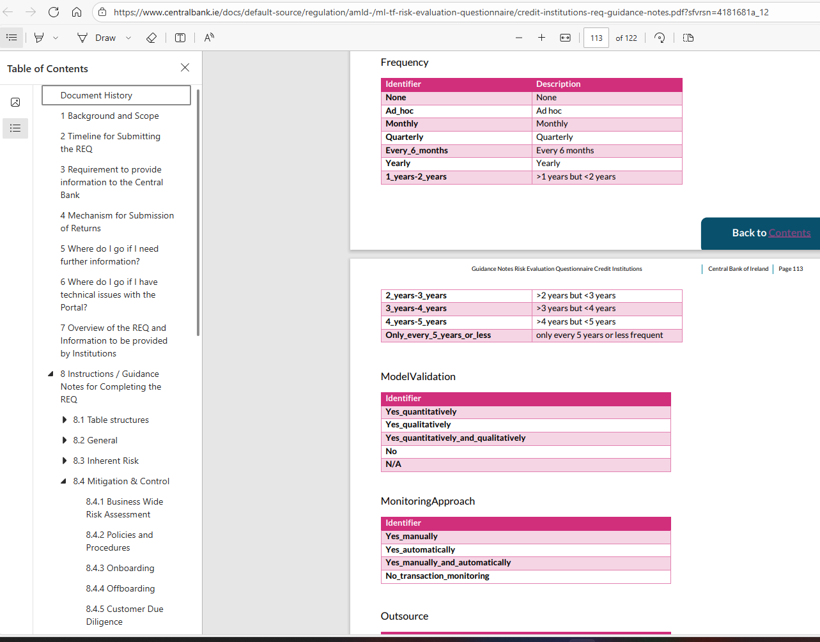
Questions - navigation
Slido #PIEMI
How do I get back to where I was in the document when I click on a hyperlink down to the Appendix?
Remember the page you were on or navigate back to the required section using left-hand side.
Alternatively, if you are using a PDF reader software like Adobe Acrobat, the Alt Left Arrow shortcut will return you to the page location of the link you clicked

Slide 47
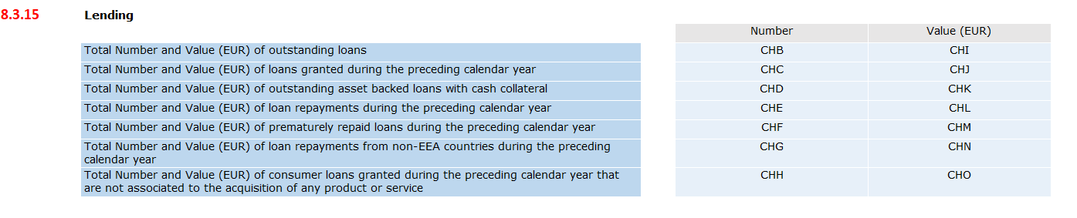
Questions - Lending
Slido #PIEMI
CHD – Outstanding asset backed loans with cash collateral – are these a Subset of CHB?
CHB – For outstanding loans. What loans are included in this? Mortgages, home improvement loans, operating leases?
Yes
Include ALL loans

Slide 48
Questions - Customers
Slido #PIEMI
Could you please confirm that new customers would be all those onboarded in the reporting period of calendar year 2024?
Please specify per country the number of your legal entity customers' BOs, and of which are PEPs, who reside in that country.
What should be captured active or inactive?
Yes
Your institution's full (active and inactive) legal entity customer base as of 31 December of the preceding calendar year.
Unless specified otherwise in a question report both active and inactive.

Slide 49
Questions – Customers
Slido #PIEMI
To avoid double counting, what is the best way to categorize merchants/customers across the following groups:
Natural Persons
Legal Entities
High Risk
Cash Intensive
Complex
For example, where a merchant is both Cash Intensive and High Risk, which classification should take precedence? Should they be counted under High Risk, Cash Intensive, or both?
As per the guidance document, customers can come under more than one customer type, and the sum of all customer types does not need to sum to the total number of customers. For example, a customer can be both a Natural Person and a High-Risk customer.

Slide 50
Questions – Virtual IBANs
Slido #PIEMI
In section 8.3.9 Virtual IBAN Accounts, do all questions refer exclusively to re-issued virtual IBANs, or does it also include normal IBANs?
Every question in section 8.3.9 refers to Virtual IBANs only

Slide 51
Questions – Currency Exchange
Slido #PIEMI
For section 8.3.8, if a Customer using an Australian issued card pays in Australian Dollars to our merchant, but the merchant gets settled in EUR, do we include this in the total of currency exchange transactions Sell/Buy or do the CBI require only transactions that are solely dedicated to buying/selling of currency?
There is no requirement to capture these kinds of currency exchange transactions under this section

Slide 52
Questions – Cash Transactions
Slido #PIEMI
In relation to the description: ‘Cash - Total Value (EUR) of Transactions amounting to €10,000 or more’ - Should this be understood as:
where a merchant has one transaction equal or higher than €10,000 or
where multiple transactions from the same merchant collectively amount to greater than €10,000?
This refers to singular transactions which are €10,000 or more

Slide 53
Questions – Policies & Procedures
Slido #PIEMI
“Date(s) when the last version of the following policies and procedures approved by the management”
Does it refer to policies including a note that an approval is required on foot of regulatory change, i.e., within the AML policy? Or does it refer to a separate policy setting out requirements for policy approvals?
It refers to the suite of policy and procedures which the firm has put in place to document all relevant aspects of its AML/CFT control framework (as per Section 54 of the CJA 2010), and which fully demonstrate consideration of and compliance with all legal and regulatory requirements.

Slide 54
Questions – Customer Due Diligence
Slido #PIEMI
We categorize customers as low, medium and high risk. How should we report this correctly given the medium-low and medium-high categorizations provided?
In case an entity uses three risk categories please classify Medium risk as Medium-low risk

Slide 55
Questions – Group Reporting
Slido #PIEMI
State whether a foreign supervisory authority issued findings on your institution's risk management. As we are a branch, should this include findings on the group as a whole, or only findings specific to Dublin branch?
We have multi-hub locations in one domicile for one legal entity (i.e. Dublin and Limerick). Would Limerick count as a representative office?
If the Limerick hub is providing direct services to customers, for which AML obligations apply, then yes, however if it’s only an operational hub then it would not count.
Only on findings specific to the Irish branch.

Slide 56
Questions – Group Reporting
Slido #PIEMI
CBP – We are a branch writing FOE business in Ireland but Ireland is not a listed country in CBP how do we report this?
In Section 7 (Mitigation & Control) there are two questions relating to CDD: "Are intragroup activities identified?" and "Are intragroup transactions identified?"
Could some examples be given in guidance to illustrate what types of activities/transactions these two questions are intended to capture?
As you are reporting from the perspective of the branch, not from the perspective of the group, we are treating Ireland as your host country which is why it is not located in the FOE/FOS list.
An intragroup activity is a service provided by one or more members of a group to another member of the same group, such as management, accounting, legal, IT or HR, etc.
An intragroup transaction is any economic exchange, such as the sale of goods, services, or assets, that occurs between two or more companies within the same corporate group.

Slide 57
Questions – Transaction Monitoring
Slido #PIEMI
In my institution, alerts are not generated by a single rule trigger. Instead, they result from a cumulative scoring model based on the aggregate scores of multiple rules. How can we report this correctly?
Whenever a sufficient cumulative score is reached to trigger an alert, all the rules combined can be treated to have "alerted". If this collective alert results in an STR filing each alerting rule can be treated as a True Positive, otherwise, treat them as False Positive.

Slide 58
Questions – Alerts
Slido #PIEMI
Under "manual transaction monitoring systems" in section 8.4.7 Alerts, is this intended to capture so called "manual alerts", by which we mean suspicions raised by teller staff in branches relating to customer transactional activity?
A manual alert is any alert that is not automatically generated by a system, suspicion alerts raised by tellers is included in this.

Slide 59
Questions – Intermediaries and Distribution Channels
Slido #PIEMI
Where we have employed salespeople in other member states – do we list them under “No. of agents” under respective member states?
Only if those salespeople are engaging directly with customers of the Firm for the purpose of providing products/services in that jurisdiction under FOE arrangements.

Slide 60
Questions – Intermediaries and Distribution Channels
Slido #PIEMI
There is a question requiring firms to disclose the number of intermediaries “that are not themselves obliged entities". Members suggest expanding the scope of this question to also include credit intermediaries which are not obliged entities, but which are authorised and regulated by the Competition and Consumer Protection Commission. Although not designated persons, these intermediaries are nonetheless regulated.
Obliged entities are defined in the AMLR, only obliged entities under the AMLR are included in this scope.

Slide 61
Questions – Reporting
Slido #PIEMI
Is it possible to include a note in the submission to the CBI explaining why certain sections contain no data as some sections are not applicable to us?
No. We understand that there are different business models that will mean some questions are not applicable to all firms. Explanation of these will not be required. If you think that your institution has a particularly strange circumstance that needs to be noted please feel free to report it through normal supervisory channels, but we would not deem this necessary in the majority of cases.

Slide 62

Questions
Slido #PIEMI

Slide 63
Questions
Slido #PIEMI
Step One: Refer to guidance document available on our website:
https://www.centralbank.ie/regulation/anti-money-laundering-and-countering-the-financing-of-terrorism/sector-specific-ml-tf-risk-evaluation-questionnaire
Step Two: Refer to Q&A document which will be on our website by the end of October
Step Three: Email to: AML_Analytics@centralbank.ie

Slide 64
Slido #PIEMI
Thank you for your attention

